Slide 1


Global metabolic interaction network of the human gut microbiota for context-specific community-scale analysis
February 12th, 2018
Jaeyun (Jae) Sung, PhD
Assistant Professor of Surgery, College of Medicine
Senior Associate Consultant, Division of Surgical Research
Mayo Clinic, Rochester, MN
Notes:
Large-scale approaches; systems approaches; omics approaches
How can we use the potential of big data and our knowledge on biological mechanisms to build advanced algorithms and computational tools to advance precision medicine?
Can we make it in time for actionable therapy?

Slide 2
Our gut microbiome is closely tied to overall health
Several health benefits
  Completes food digestion
  Provides energy sources and essential nutrients (e.g. SCFAs, Vitamin K, B₁₂)
  Eliminates invading pathogens
  Influences our metabolism, immune system, and mood
Associated with many diseases
1 of 17
Notes:
Change figure

Slide 3
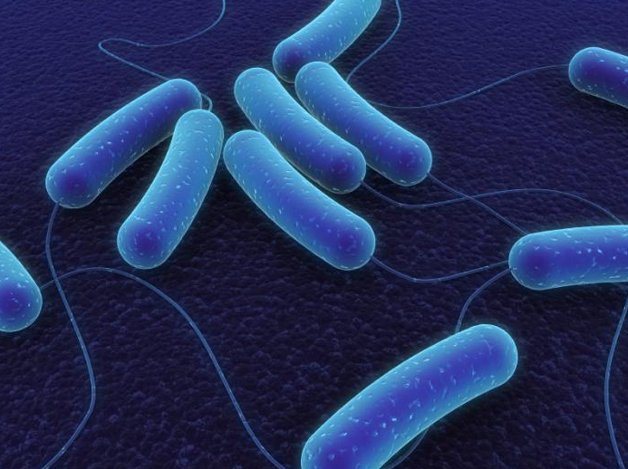
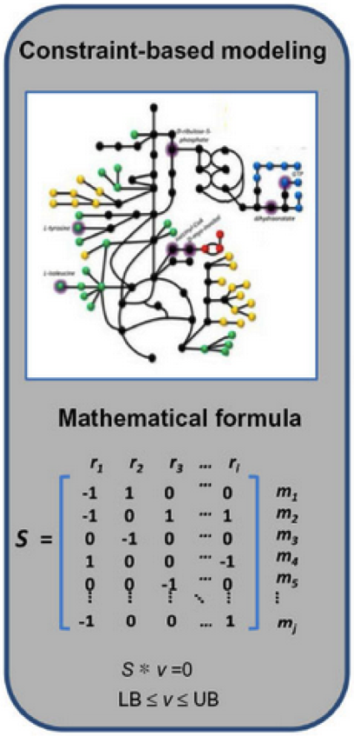
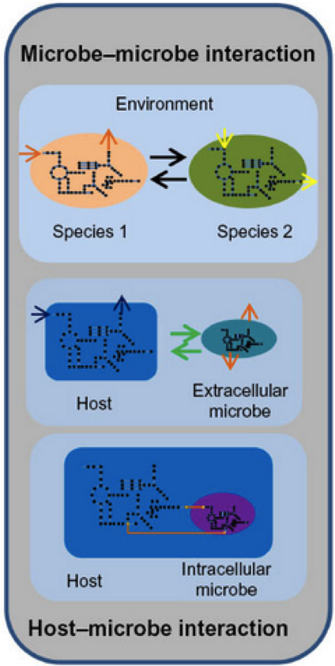
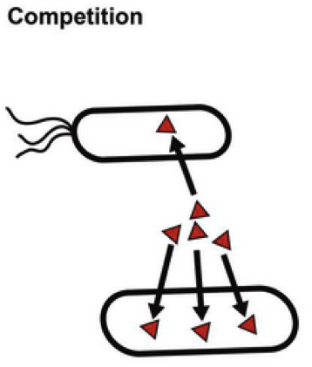
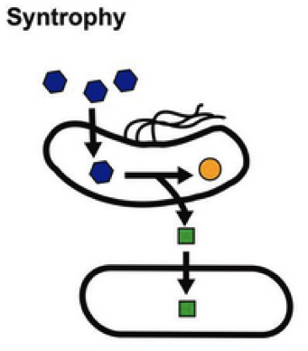
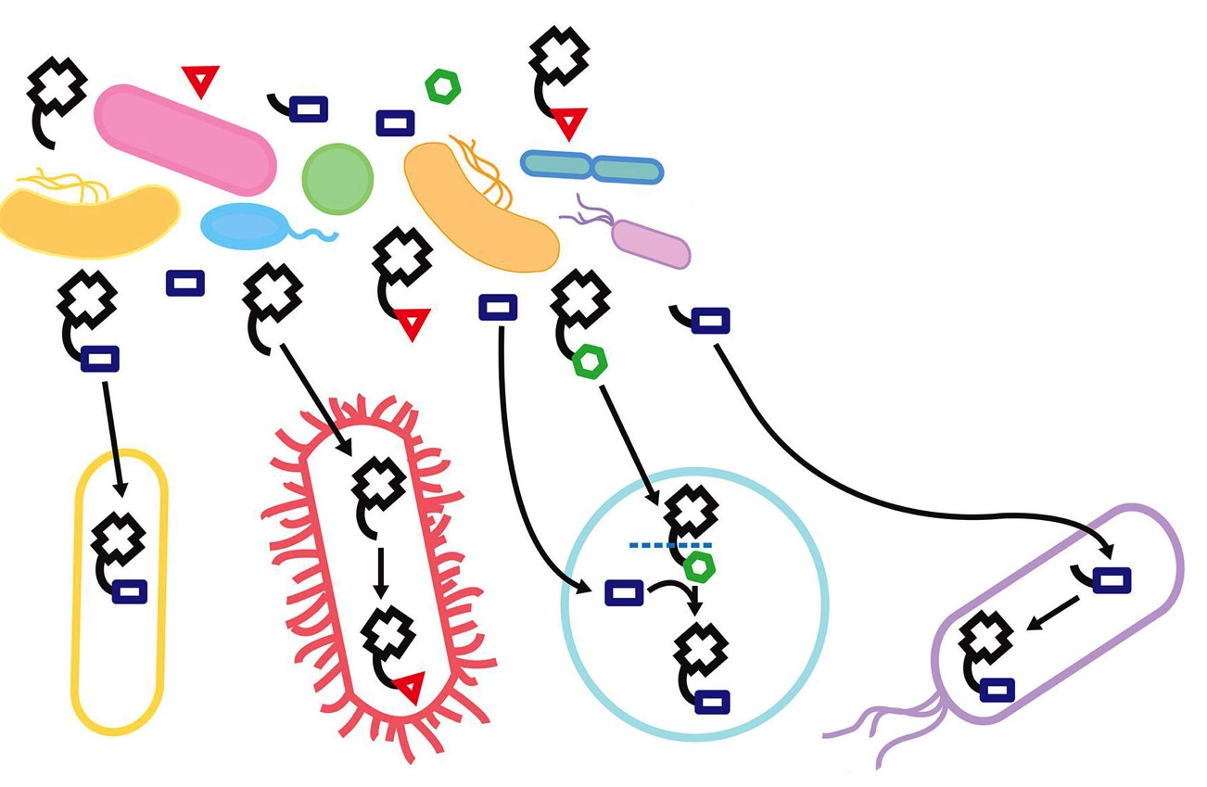
How can we study global interactions within a complex gut microbial community?

Slide 4
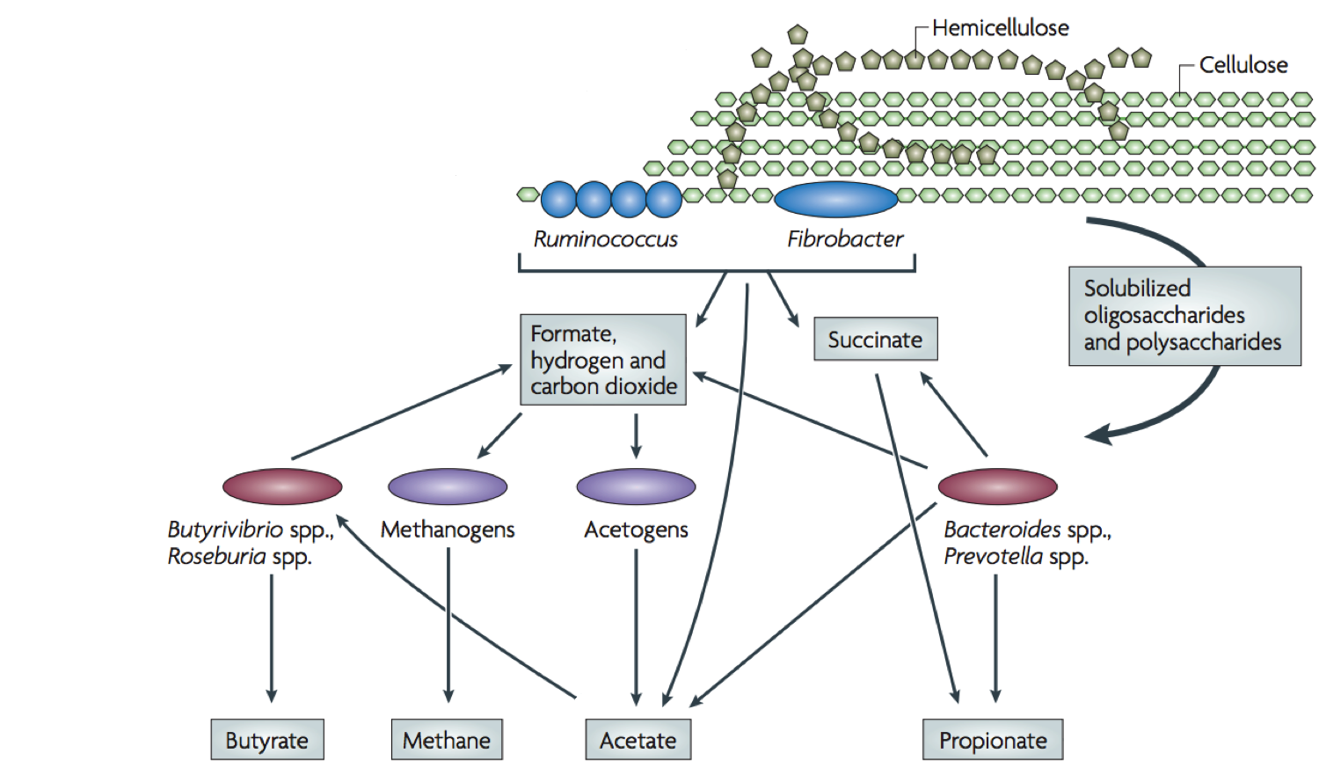
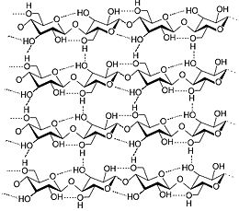
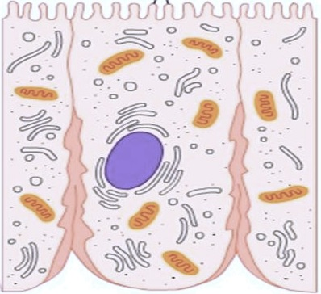


Interactions among gut microbes via metabolic cross-feeding
Plant cell wall
Colon cells
Flint et al. Nature Reviews Microbiology (2011)
3 of 17

Slide 5
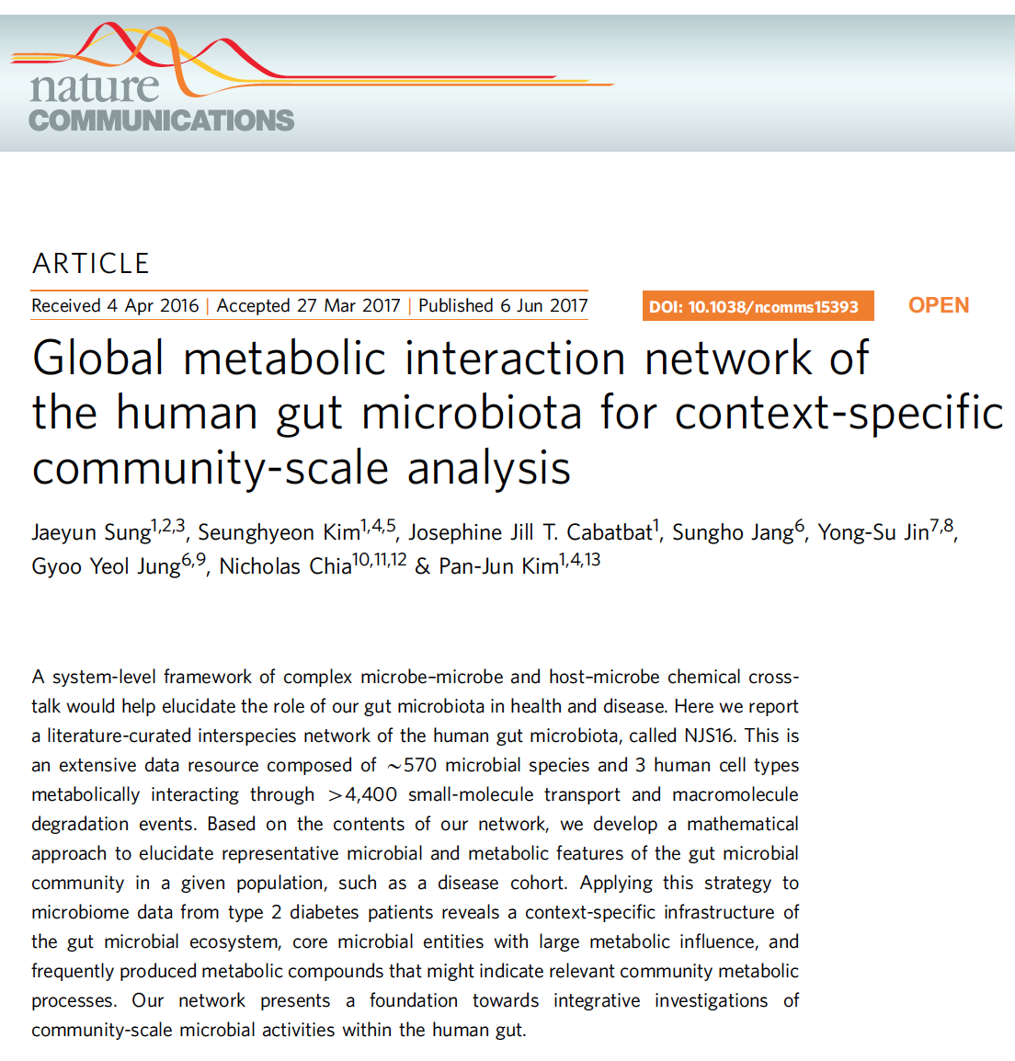
We propose a computational model of the interactions of the human gut microbiome based on metabolic transport reactions
A mechanistic global model is a key step towards insight into:
  biological/mathematical properties of the community structure
  microbe-microbe, microbe-host relationships via metabolic influence
  interactions as putative disease signatures?
4 of 17

Slide 6
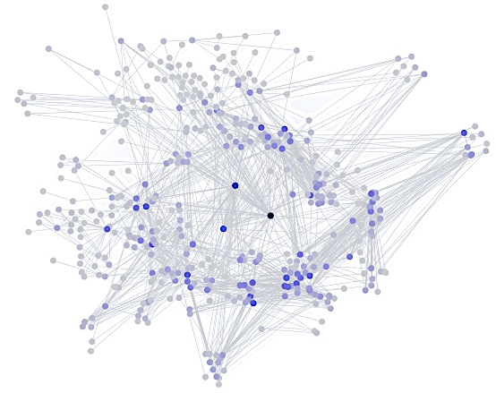
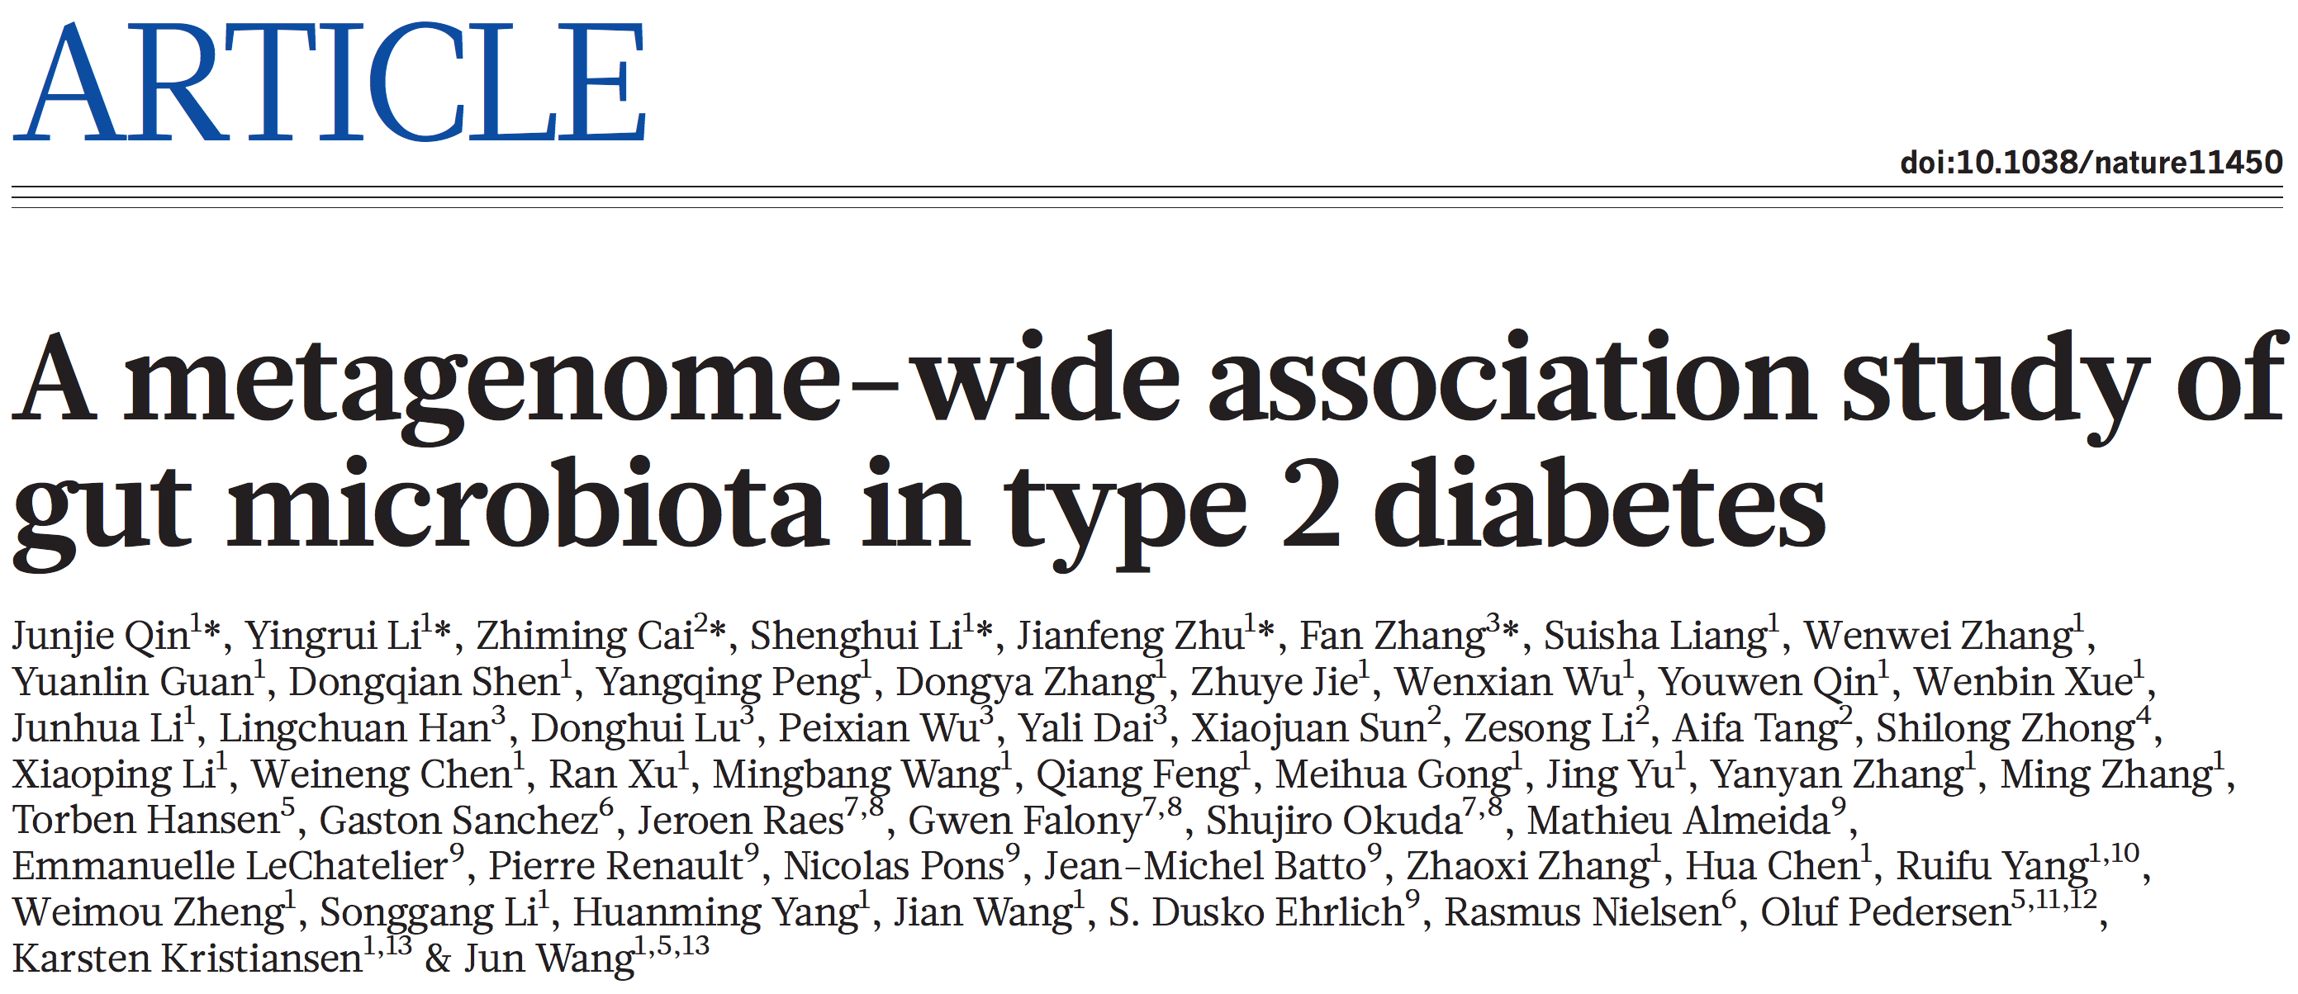
Finding microbe-compound associations (cont’d)
1
2
3
4
Microbiome Sample Collection
Qin et al. Nature 2012
5 of 17

Slide 7
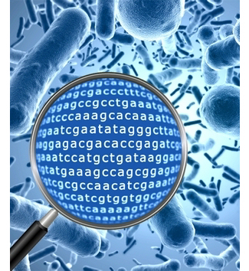
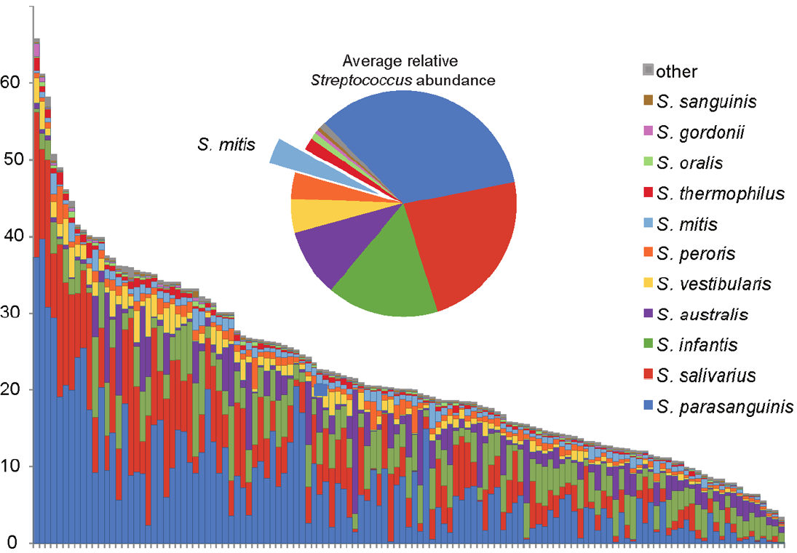
Finding microbe-compound associations (cont’d)
1
2
3
4
Species identification
metagenomes
species abundance distribution
5 of 17

Slide 8
Finding microbe-compound associations (cont’d)
1
2
3
4
Import & export metabolite identification
400+ published references
(bibliome of experimentally-validated transport reactions)
5 of 17

Slide 9
Finding microbe-compound associations (cont’d)
1
2
3
4
Import & export metabolite identification
567 microbial species
& 3 host cell-types
5 of 17

Slide 10
Finding microbe-compound associations (cont’d)
1
2
3
4
Import & export metabolite identification
228 transportable small-molecule metabolites
  sugars & derivatives
  amino acids & derivatives
  fatty acids & carboxylates
  vitamins & co-factors
  gases
  inorganic salts
228 transportable small-molecule metabolites
  sugars & derivatives
  amino acids & derivatives
  fatty acids & carboxylates
  vitamins & co-factors
  gases
  inorganic salts
15 food macromolecules & host-derived products
  dietary polysaccharides
  mucin glycoproteins
  bile acids
5 of 17

Slide 11
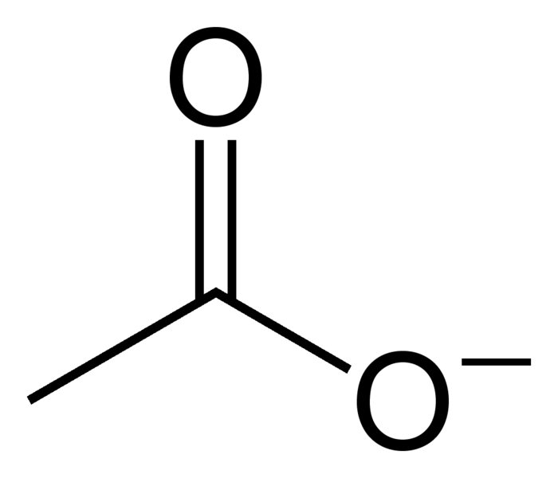
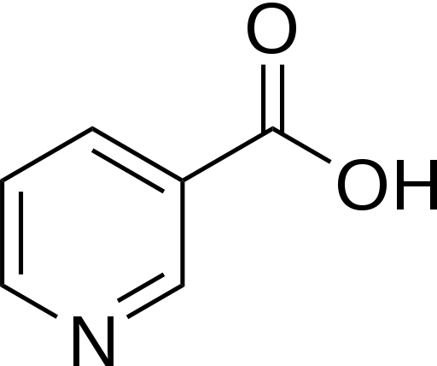
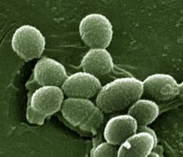
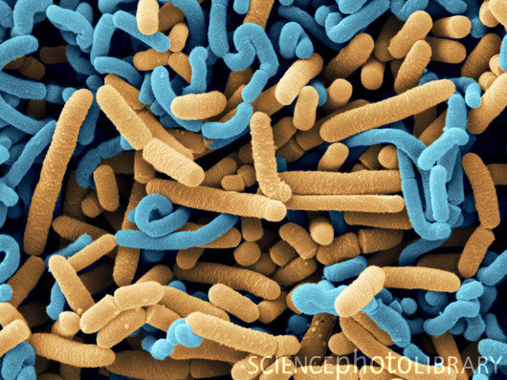
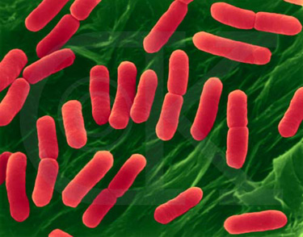
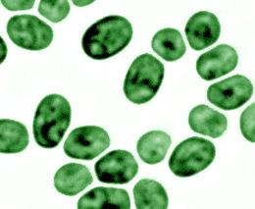
Finding microbe-compound associations (cont’d)
1
2
3
4
Microbe-compound bipartite network
acetate
niacin
...
5 of 17

Slide 12
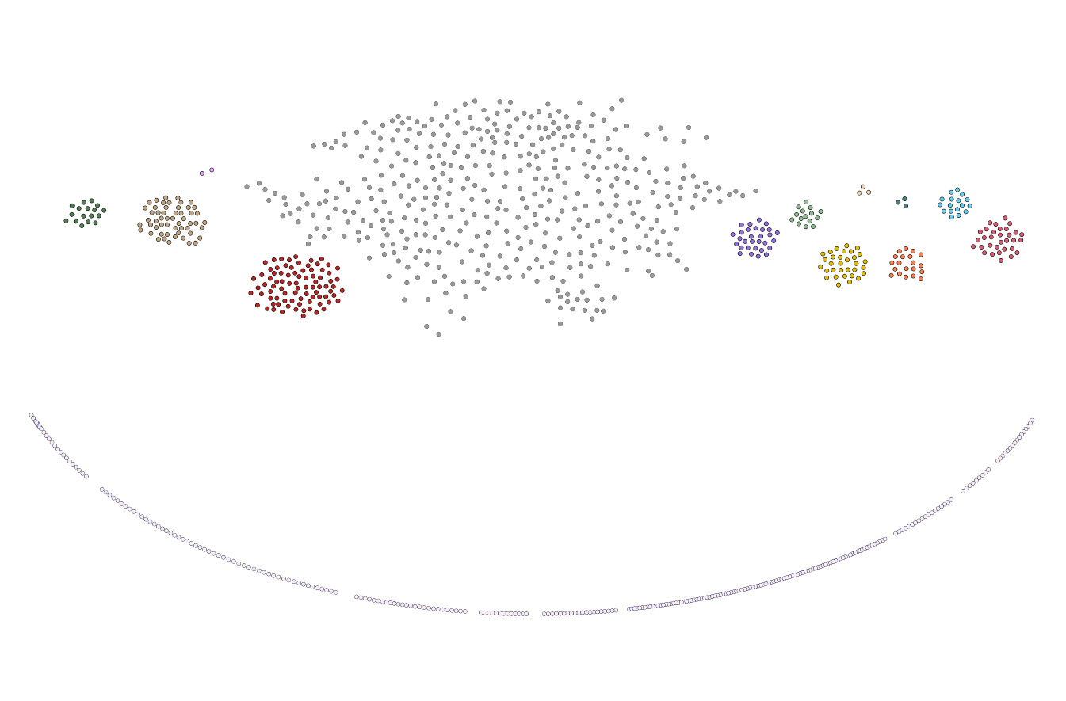
Microbe-Compound bipartite network
propionic acid
bacteria
Microbial species (567)
cellulolytic
acetogens
methanogens
sulfate
reducers
lactic acid
bacteria
Metabolic compounds (244)
Macromolecules
Gases
Mono-/disaccharides
& derivatives
Inorganic ions
Amino acids, oligopeptides, & derivatives
Nucleic acids & oligonucleotides
Fatty acids & glycerides
Vitamins & co-factors
6 of 17

Slide 13
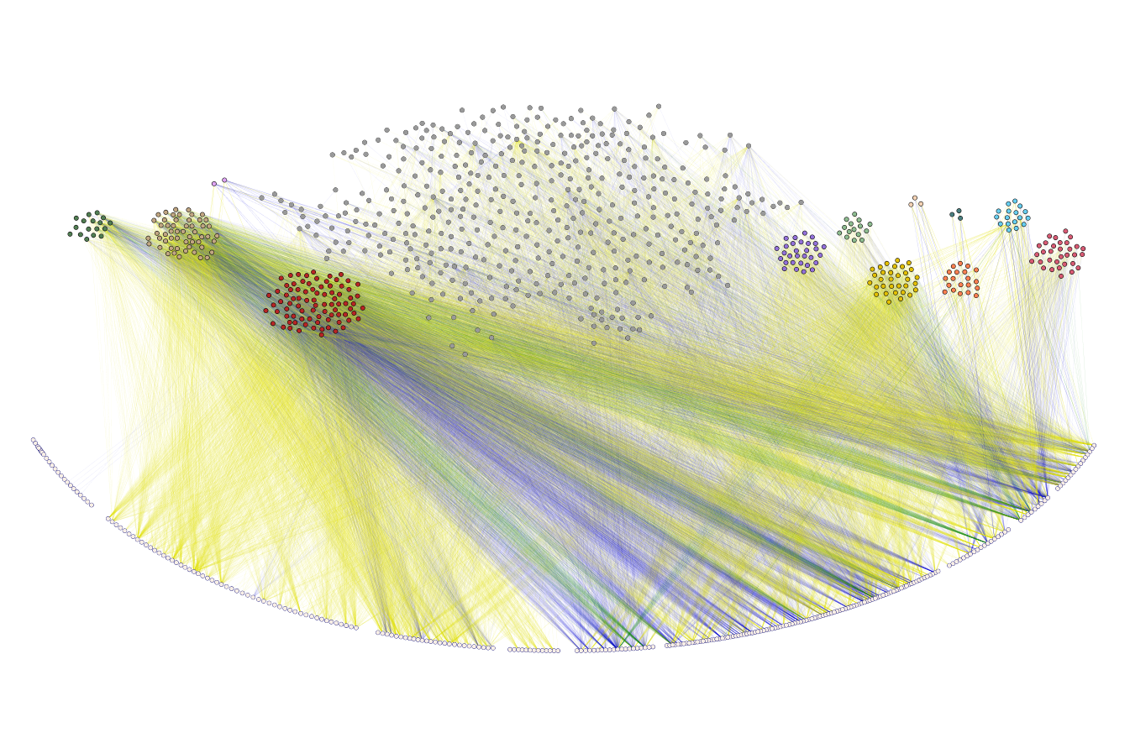

Microbe-compound bipartite network (NJS16)
propionic acid
bacteria
Microbial species (567)
cellulolytic
acetogens
methanogens
sulfate
reducers
lactic acid
bacteria
Metabolic compounds (243)
Macromolecules
Inorganic ions
Mono-/disaccharides
& derivatives
Gases
Amino acids, oligopeptides, & derivatives
Fatty acids & glycerides
Vitamins & co-factors
Nucleic acids & oligonucleotides
6 of 17

Slide 14
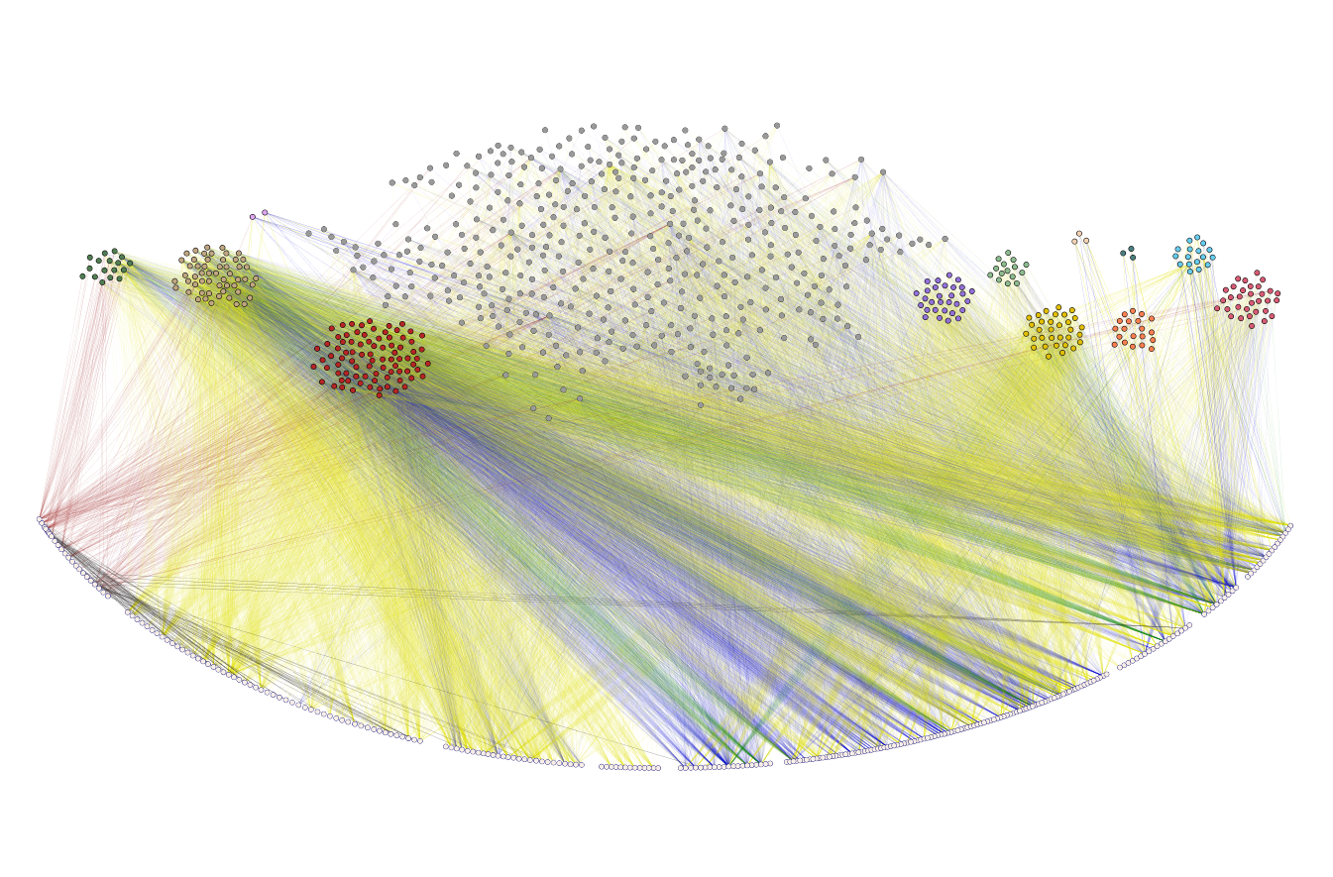

Microbe-compound bipartite network (NJS16)
propionic acid
bacteria
Microbial species (567)
cellulolytic
acetogens
methanogens
sulfate
reducers
lactic acid
bacteria
~4,500 literature-curated
small-molecule transport and macromolecule degradation events
Metabolic compounds (243)
Macromolecules
Inorganic ions
Mono-/disaccharides
& derivatives
Gases
Amino acids, oligopeptides, & derivatives
Fatty acids & glycerides
Vitamins & co-factors
Nucleic acids & oligonucleotides
Sung et al. Nature Communications, in press
6 of 17
Notes:
Specifically, our network shows how individual microbes interact with:
their chemical environment (via metabolite import, export, and macromolecule degradation)
and thereby with other microbes (via resource competition, interspecies
cross-feeding, and releasing macromolecule degradation products as public goods).

Slide 15
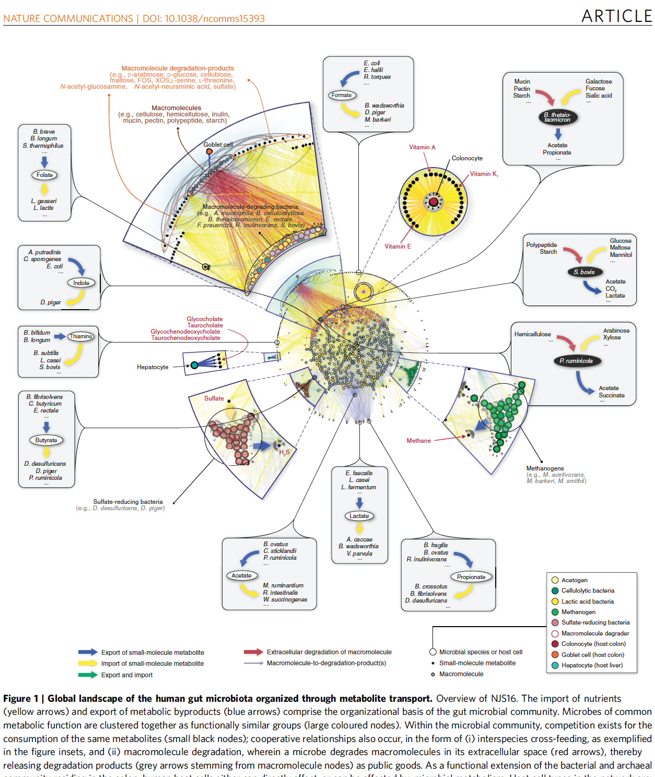
7 of 17

Slide 16
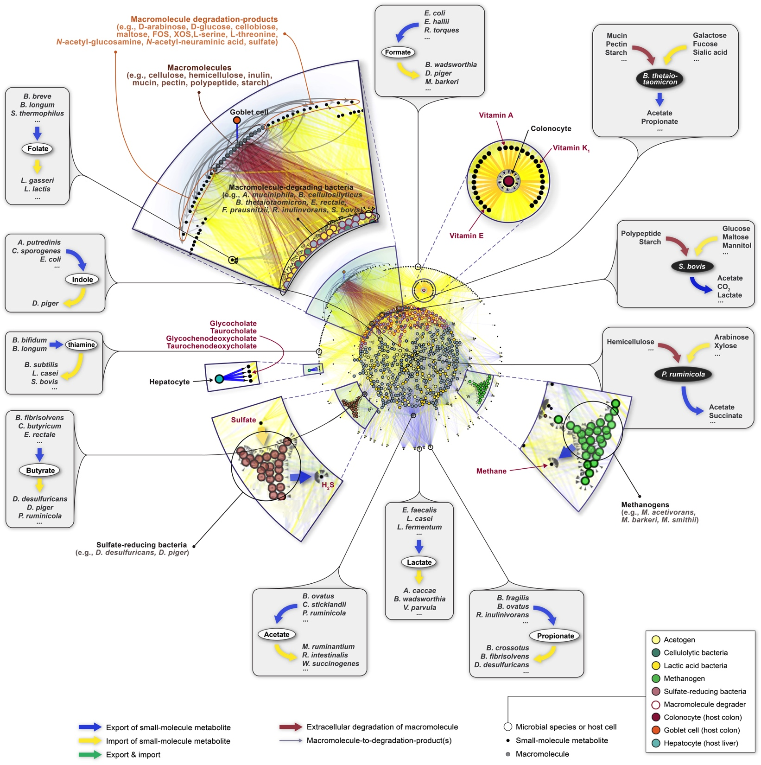
Notes:
As clearly seen in these examples, metabolite-driven cooperative relationships are pervasively seen throughout the entire network (Fig. 1).
Using NJS16, we can now begin to explore the organizing characteristics of global microbial metabolic activities in the human gut environment.

Slide 17
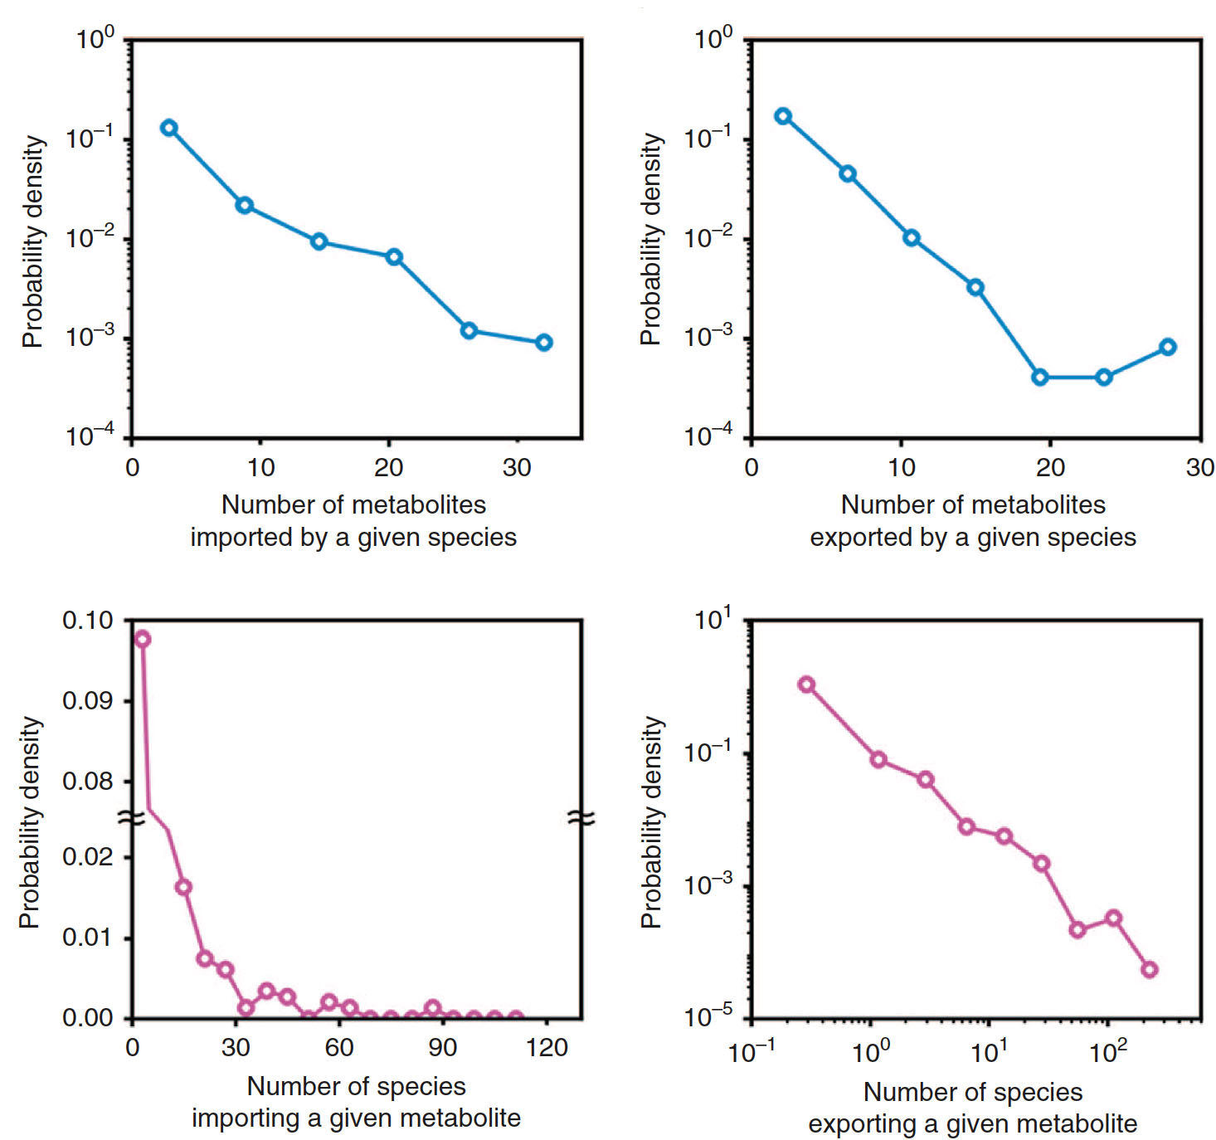
Mean: 5.1
P(k) ~ e ^{-0.2k}
Mean: 3.9
P(k) ~ e ^{-0.4k}
Mean: 13.4
Mean: 20.7
P(k) ~ k ^{-1.6}
8 of 17
Notes:
Structural properties of NJS16
Metabolites are highly uneven in terms of their usage by microbes!

Slide 18
7 of 17

Slide 19
Modeling growth within gut microbiome community:
Characterizing growth influence of one microbe to another
Modeling growth within gut microbiome community:
Characterizing growth influence of one microbe to another
Defining Microbial Metabolic Influence
1 if microbe-i produces metabolite k; else, 0
abundance of microbe-i
microbe-i’s influence
on microbe-j’s growth
compound-k production term
compound-k consumption term
metabolite consumed by microbe-j
1 if microbe-i consumes metabolite k; else, 0
9 of 17
Notes:
This network, which we will call henceforth the microbial metabolic influence network (MIN), is based on actual microbial relative abundance information from the relevant T2D and control microbiome samples, i.e., context-specific abundance information.
the potential metabolic influence of one entity i upon another entity j’s growth (and vice versa). The sign of this quantity can indicate whether the metabolic influence is positive (growth-promotive) or negative (growth-inhibitive).

Slide 20
Modeling growth within gut microbiome community:
Characterizing growth influence
species-i
or
microbe-i
microbe-j
genus-i
or
compound
group-i
microbe-i
microbe-j
microbe-i
microbe-j
differentially abundant in Healthy
differentially abundant in disease
Healthy
Healthy
Links consistent with actual abundances
Links inconsistent with actual abundances
disease
disease
Healthy
disease
10 of 17
Notes:
Consistency between metabolic influences and abundance changes
We only consider links that are consistent with actual microbe abundance changes between control and T2D

Slide 21
Categorization of microbiome samples
Microbiome data from Type-2 Diabetes (T2D) patients and non-diabetic controls
  Qin et al., Nature 2012
  Samples collected from Chinese population
  Phenotypes
    non-diabetic controls (185 total samples)
    T2D (178 total samples)
      Metformin-treated
      Metformin-free
Samples can be partitioned into cohorts using patients’ meta-data:
  gender
    male
    female
  age
    young (age < 45)
    mid-age (45 ≤ age < 65)
    old (65 ≤ age)
  Body Mass Index
    underweight (BMI < 18.5)
    normal BMI (18.5 ≤ BMI < 25)
    overweight (25 ≤ BMI)
Male, mid-age, normal BMI cohort: Control (n = 22) | T2D (n = 11)
11 of 17

Slide 22
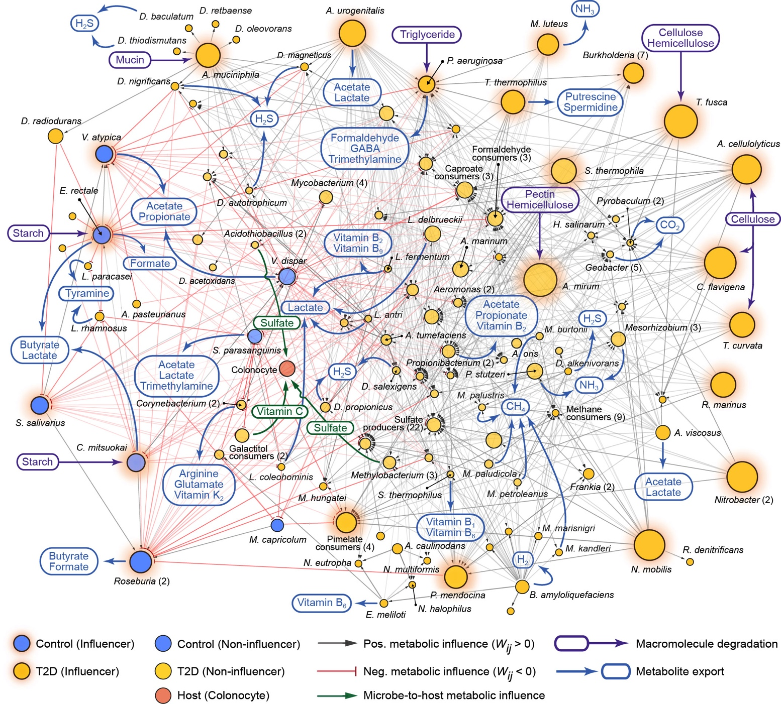
Metabolic influence network (Male / mid-age / normal BMI)
12 of 17
Notes:
our network can be investigated for identifying interaction pathways or modules that are associated with particular clinical conditions.
NJS16: shows entire spectrum of microbe-metabolite associations;
MIN: offers focused view of the most relevant microbe-microbe and microbe-host relationships

Slide 23
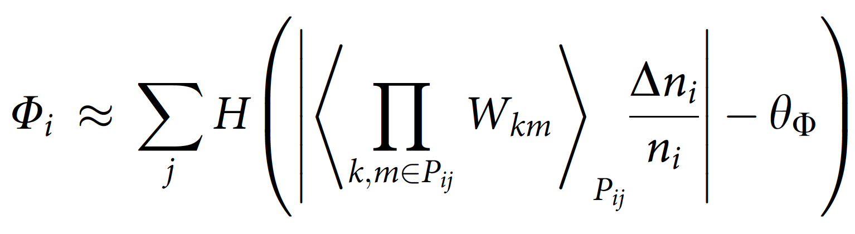
Community metabolic influence of a microbial entity i (Φ_{i}):
To how many total community members does i exert a very positive or negative influence? (directly or indirectly)
microbe-k’s influence
on microbe-m’s growth
microbe-i’s influence
on entire community
i’s relative abundance change
from Healthy to Disease
unit step-function
one of the shortest paths connecting i and j
13 of 17

Slide 24
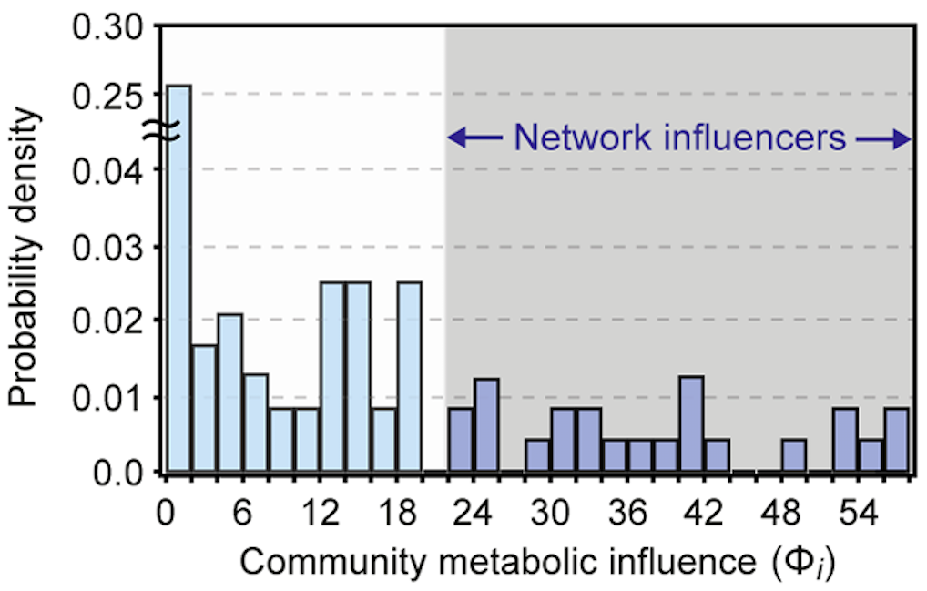
Network Influencers: microbial species or groups with relatively large metabolic influence
(17.6% of entities)
Probability
Density
14 of 17

Slide 25
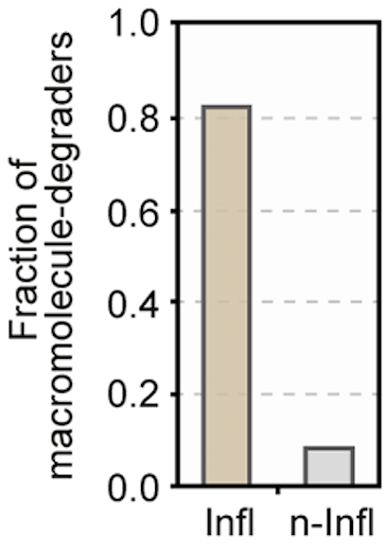
Macromolecule degradation is a key hallmark of network influencers
Fraction of
Macromolecule-degraders
15 of 17

Slide 26
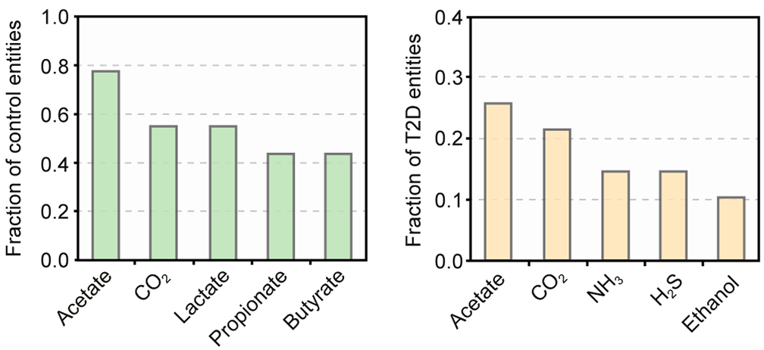
Top 5 most commonly produced metabolites of control & T2D microbial entities
Control
T2D
Propionate, butyrate: known to have beneficial effects on host physiology, e.g. intestinal gluco-neogenesis, increase in energy expenditure, and anti-inflammatory effects
Lactate: lactic acid bacteria linked to anti-diabetic activities
NH₃, H₂S: associations to adverse health effects, e.g. genotoxic agents
16 of 17

Slide 27
Take-home messages
Microbiome studies should incorporate more comprehensive analytical strategies for understanding:
  Disease-associated microbial taxa & groups
  Information flow of biochemical signals
  Community-scale metabolic activities
  Host-microbiota relationships
Comprehensive models can provide systems-level interpretation:
  NJS16: Literature-curated, metabolic interaction network of human gut microbes
    Metabolic transport reactions for 567 microbial species + 3 human cell types
    ~4,500 species-metabolite (or macromolecule) links
  Metabolic influence network provides insight into global hierarchy
    Combination of deterministic (i.e. mechanistic) modeling & statistical inference
    A top-down strategy for probiotic design?
17 of 17
Notes:
To provide a global framework for understanding community metabolism within the human gut,
we have presented in this study a network architecture encompassing the myriad relationships among
gut microbial species, host cells, and chemical compounds.
Our metabolic-centric topology of gut microbiota interactions has revealed noteworthy
connections among interspecies cross-feeding pathways in T2D.

